Slide 1

Team Instinct
Showcase
2022-06-25

Slide 2
AGENDA
Data Model
The Travelers
Forecasting and Retail Agents
Billboard Pitch
Seasonality

Slide 3
DATA MODEL
Initial state of the dataset was a collection of *.csv files (some sharded) with many string fields (especially entity identifiers).
Deterministic Ordinal Serialization encodes string identifier fields. Reduced storage complexity by a lossless compression ratio of ~10:4
Engineered purpose designed data loaders to further reduce the memory complexity by a lossless compression ratio of ~10:2.3

Slide 4
DATA MODEL
Need for a distributed cluster to perform some of our intended EDA still persisted
Provisioned a Star Schema based data warehouse on Google BigQuery
Provided ease of on-the-fly extendibility to the data warehouse
The denormalized form allowed us to write small rough-and-ready queries for EDA
Allowed us to offload the analytics computation to the cloud

Slide 5
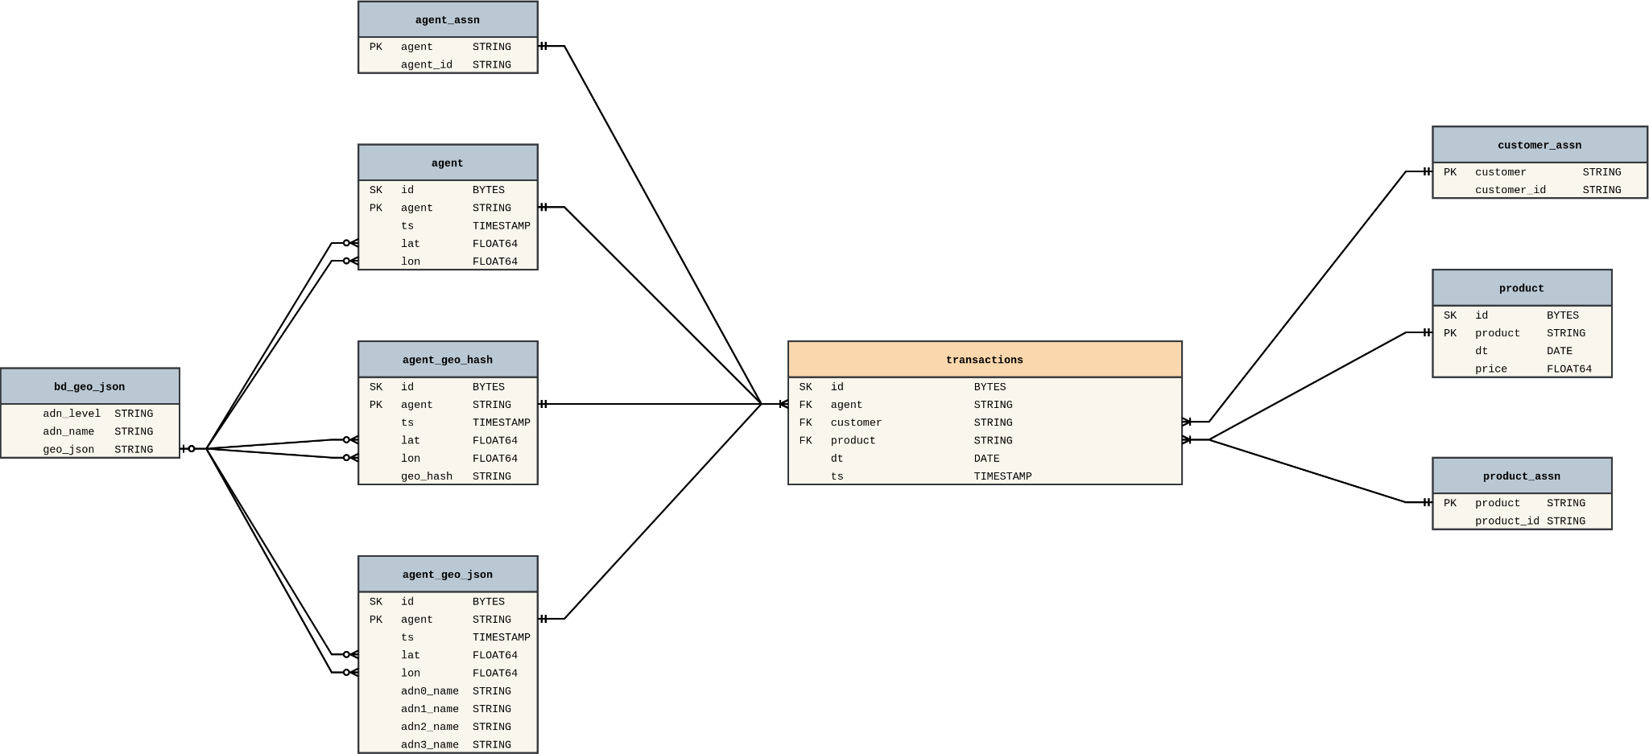
DATA MODEL

Slide 6
THE TRAVELERS
Our definition of a top ‘Traveler’ is based on 3 key metrics and 1 supporting metric:
- Average Distance traveled per transaction
- Unique Agents Transacted
- Number of transactions
- Agent Uniqueness
Only customers who were in the 95th percentile for the key metrics were considered, which accounted for around 2400 people.

Slide 7
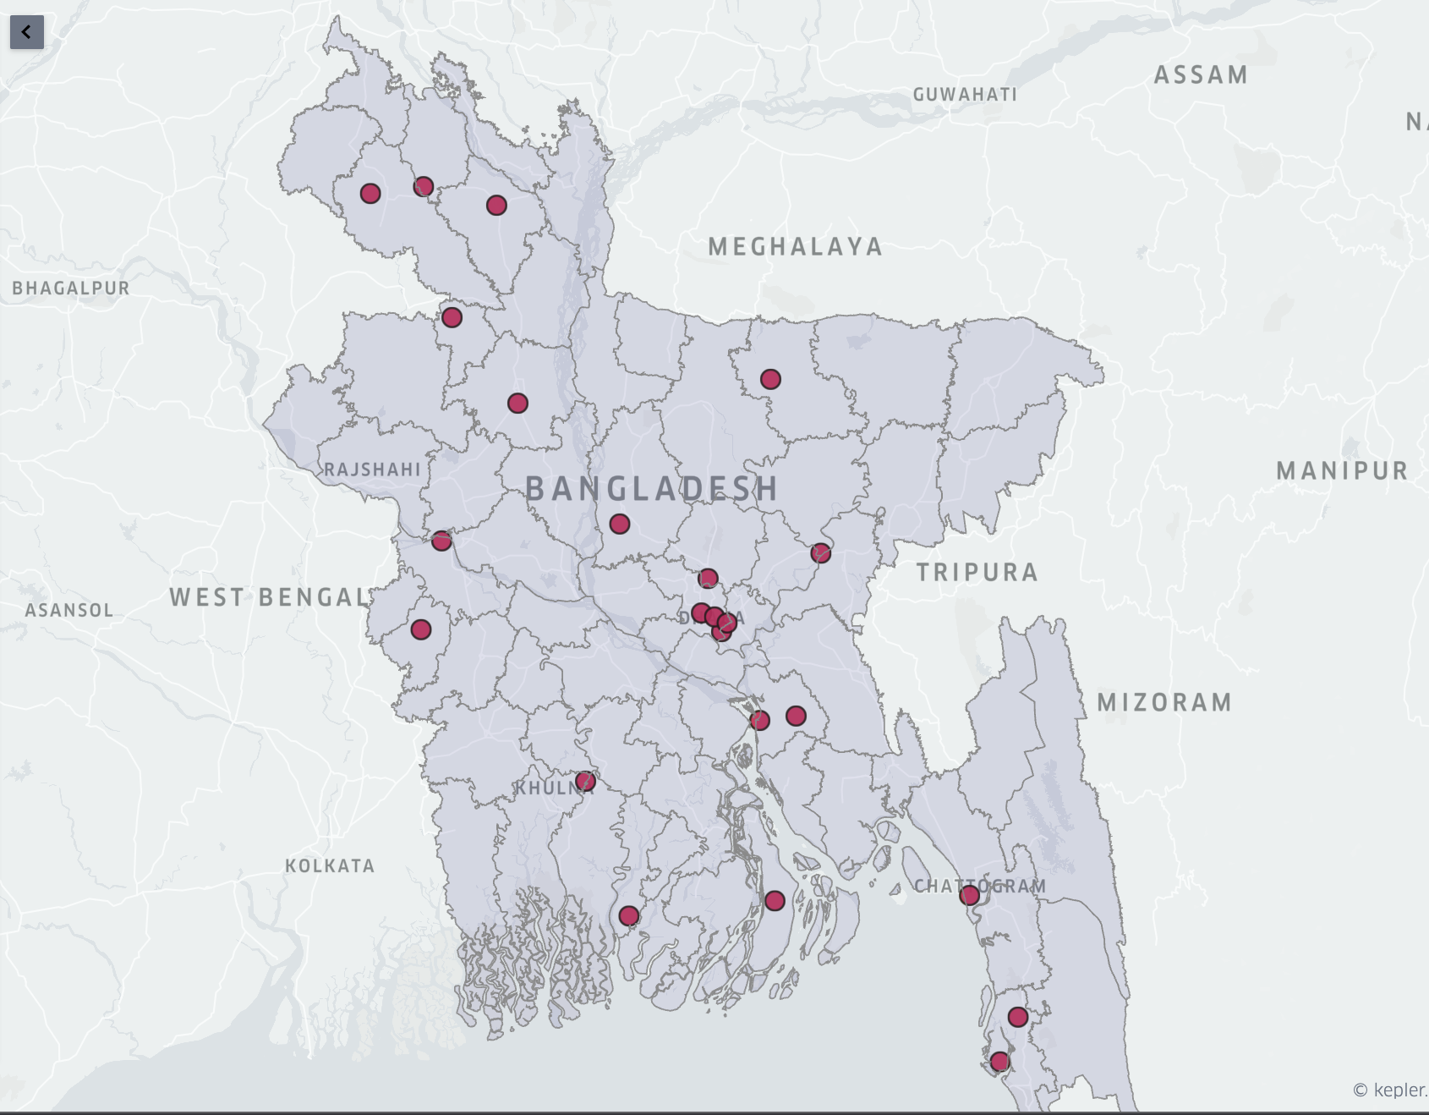

Slide 8
THE TRAVELERS
Retails serving highest number of top travelers tend to be along major highways near Dhaka and approaching Chittagong. This indicates that many travelers transact while on break during transit.
New product for travelers.
- Bundle voice and data package for short duration
- Will be tailored to make the offer lucrative to travelers
- It can only be availed via chosen retailers

Slide 9
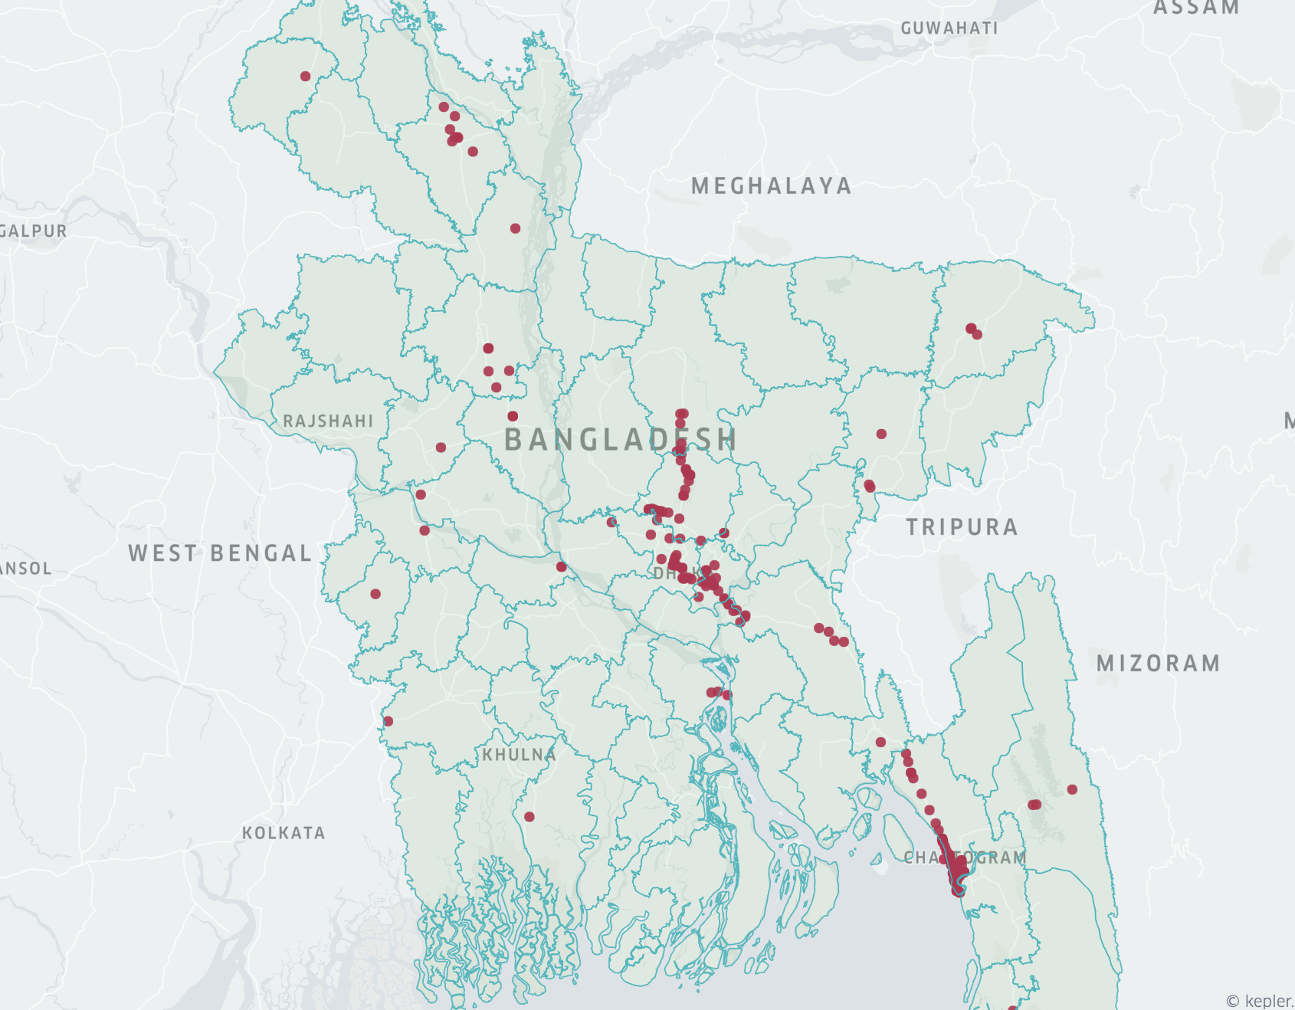
THE TRAVELERS

Slide 10
TOP 100 AGENTS
Amongst top selling 100 retail, 8 of the retails have no other retail point within 500 meters radius.
Recommendation for these retails are:
These retails deal with a lot of customers, hence, good medium to market new/other products/services.
New retailers around these retails can be introduced.

Slide 11
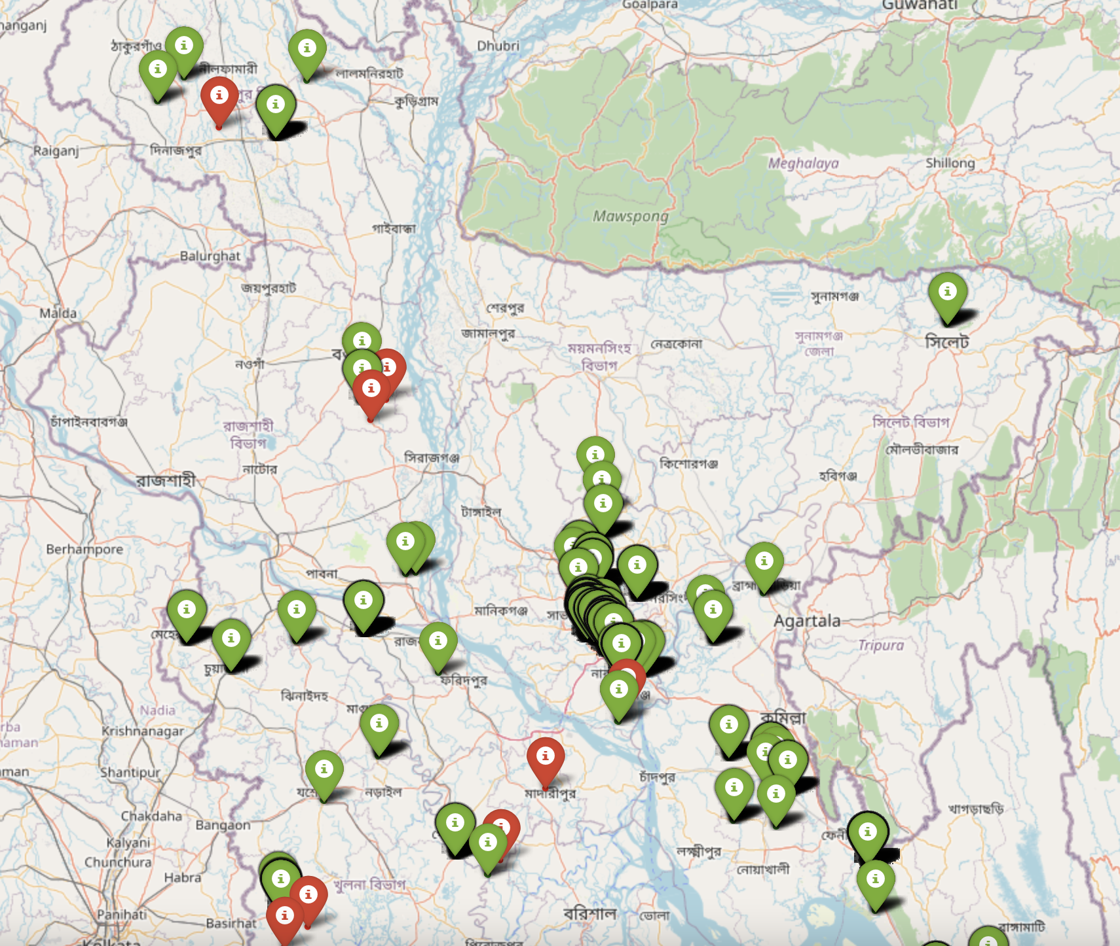
AGENT

Slide 12
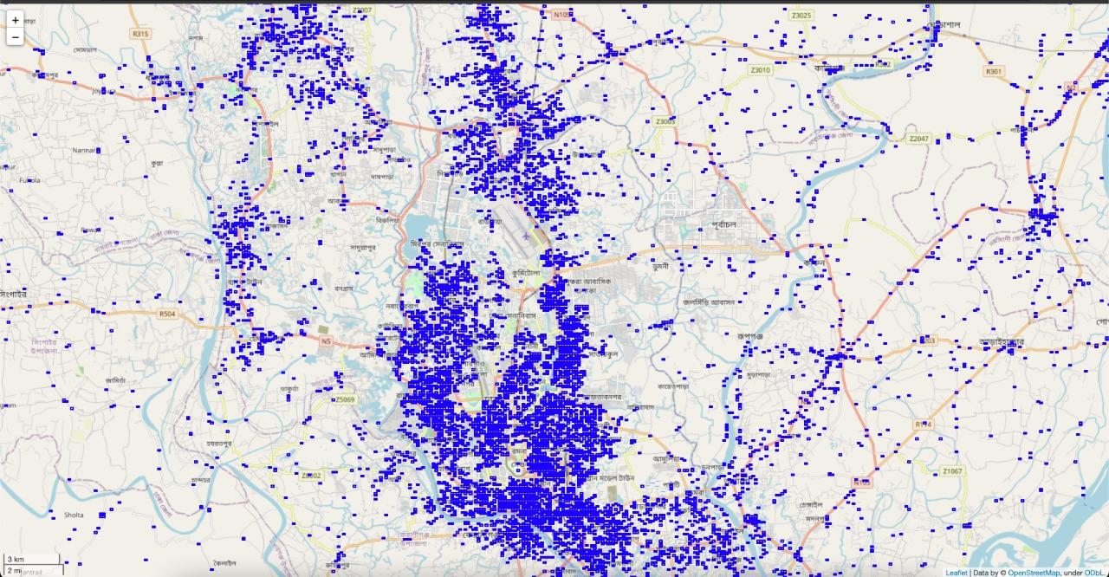
AGENT
There are 54,099 geohash (1.2 Km x 0.6 Km) with 89,610 retailer.

Slide 13
MONOPOLY AGENTS
For the next 10 retailer deployment, the zones having good sales but low agents should be considered.
The top districts with highest number of monopoly agents:
Chittagong
Comilla
Cox's Bazar
Noakhali
Chandpur

Slide 14
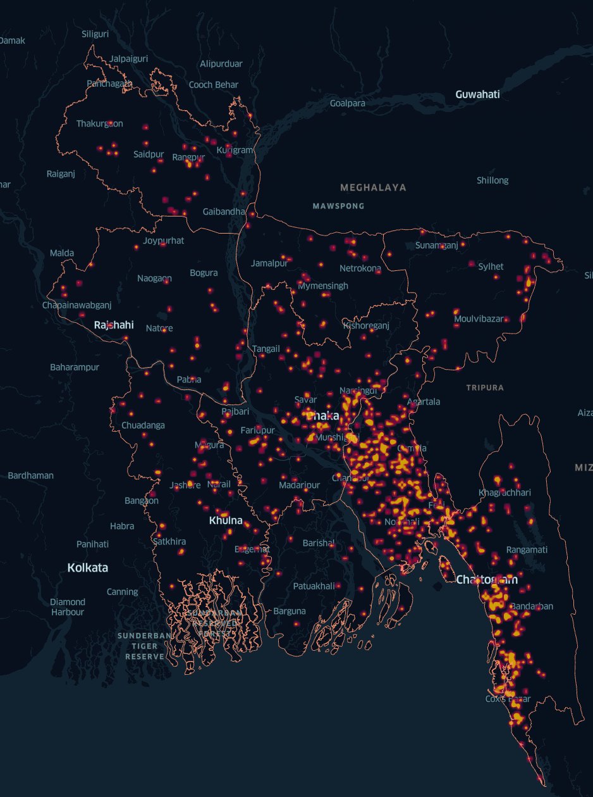
MONOPOLY AGENTS

Slide 15
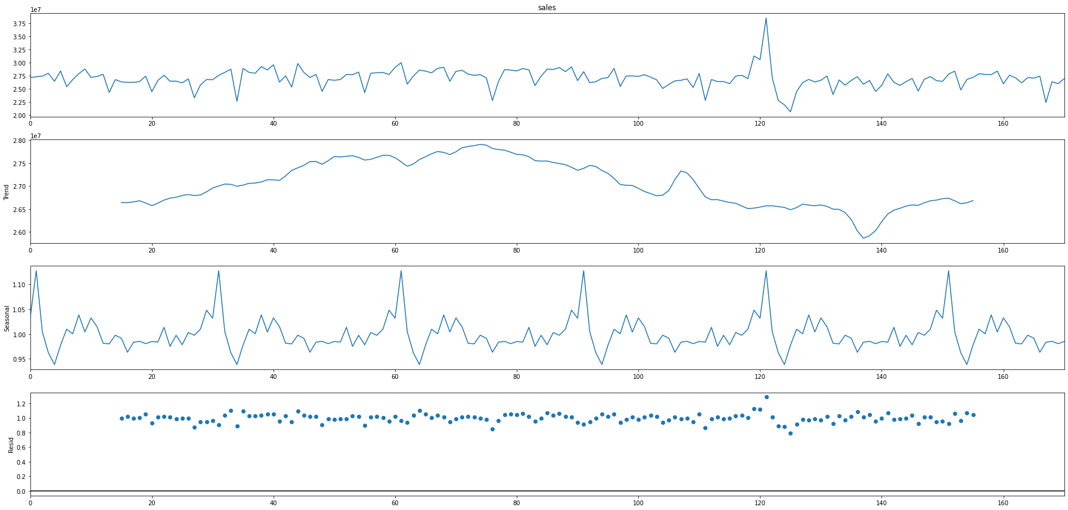
FORECASTING
Next Week’s Daily Total Sale

Slide 16
FORECASTING
Next Week’s Daily Total Sale
The seasonal decomposition shows a multiplicative nature.
Has trend component, seasonality component.
The model trained is an ARIMA(0, 1, 0) - a random walk model.

Slide 17
FORECASTING
Forecasting Next Day's Sales for Each Retail
Fitting an individual model for each of the retails is not a scalable solution.
One single time series model won’t be able to generalize well.
we thought of attacking the problem by looking at the data in a tabular form.

Slide 18
FORECASTING
Features
Day of Week - 0,1,2,3,4,5,6,7
No of Neighbor Retails - Retail points within 500m radius.
Distinct Products - Distinct products/services the retailer has.
Distinct Product Value - Monetary value of distinct products.
Previous 5 Weekdays Sales - E.g., for predicting this Tuesday's sales for a retailer we consider previous 5 Tuesday's data.
District

Slide 19
FORECASTING
Modelling & Evaluation
Initially, we used rolling average of the previous 5 weekdays sales values to establish a baseline of the model's accuracy. We got an MAE of ~230.
With the newly engineered featured, feature preprocessing, a hypertuned XGBoost regressor trained on 80% of the training set, we obtained an MAE of around ~110.

Slide 20
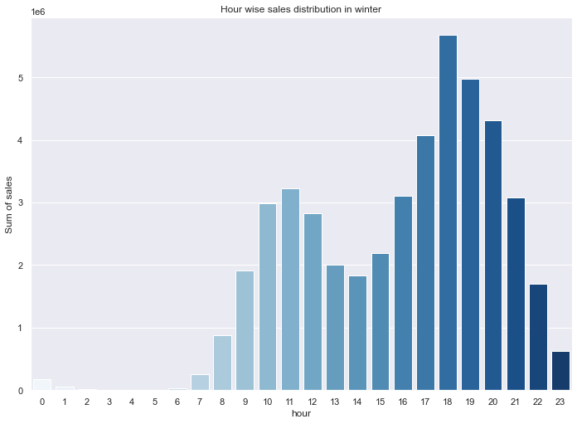
SEASONALITY
During winter season the peak hour is between 6PM and 7PM
People w/ purchasing power are in office during morning hours. Hence, morning peak is lower than evening peak

Slide 21
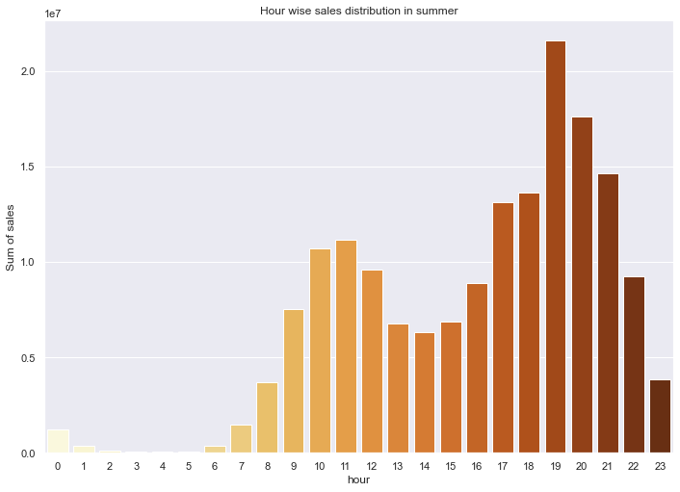
SEASONALITY
During summer the peak hour shifts to 7PM upto 8PM
This peak hour shift gives us an idea about natural daylight saving phenomenon

Slide 22
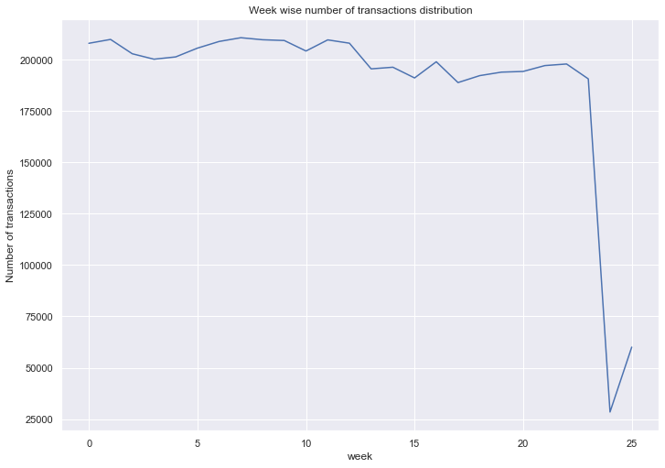
SEASONALITY
Transactions fell during Ramadan
Has stayed the same since. This could be due to inflation
Lockdown and Covid restrictions impact the transaction volume negatively

Slide 23
SEASONALITY
During the month of Ramadan we can notice a sharp decline in transactions during Iftar hour 6PM to 6:59PM
Transactions fell during Ramadan
Has stayed the same since then. This could be due to inflation
We can release a new products targeted for the price sensitive users to mitigate the fall in transaction volume

Slide 24
BILLBOARDING
Top 2 most popular products are Product 16 and Product 17 with ~8.8 million and ~8.6 million transactions respectively
Product 16 has high density in Dhaka and Chittagong
Product 17 is more prevalent across the country

Slide 25
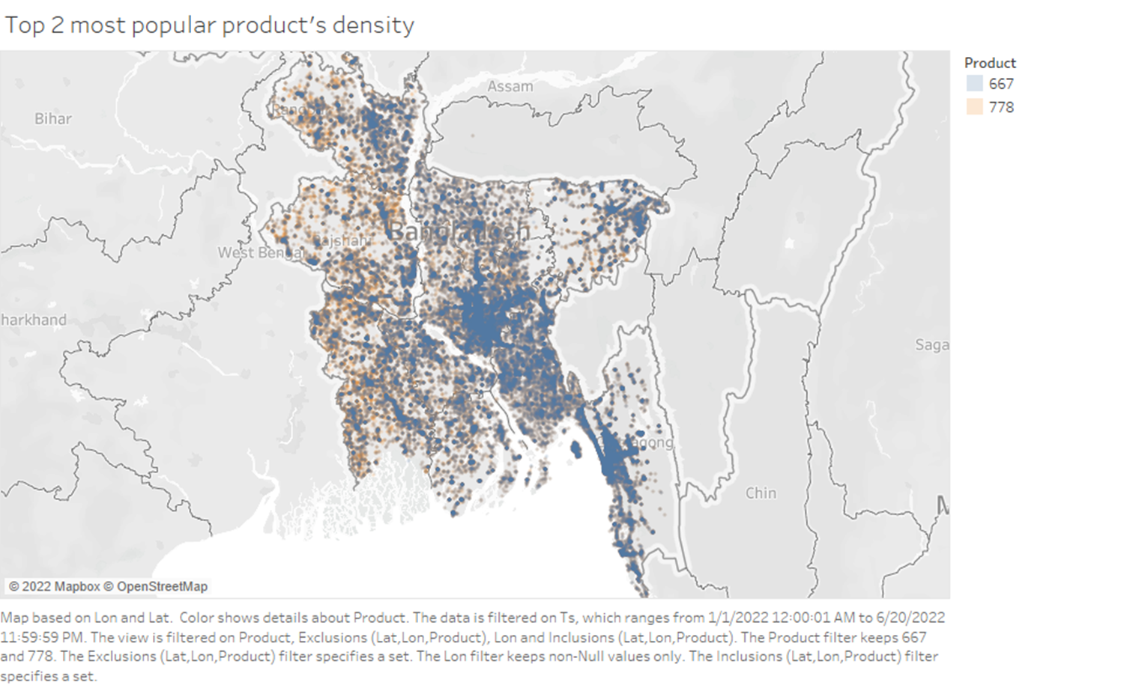
BILLBOARDING
Product 16 is a send cash or digital payment feature
Product 17 might be a cash out feature
Legend:
Product 16
Product 17

Slide 26
BILLBOARDING
Dhaka/Chittagong are already saturated
Recommend to place the billboard in emerging markets (e.g. Khulna)
Product 16 has a low barrier to entry (high volume, low price)
Serves to effectively acquire new customers
Establishes the MFS’ presence through visibility/engagement
Goal is to capture the emerging market and gain the first-mover’s advantage

Slide 27
THANK YOU
All our supplementary resources are available here

